Slide 1

SWE 321: Data Communication
SWE 321- Lecture 03
Afsana Begum
Department of Software Engineering
Daffodil International University

Slide 2
Overview:
  Review
  OSI Model
  Layer 1 - The Physical Layer
  Layer 2 - The Data Link Layer
  Layer 3 - The Network Layer
  Layer 4 - The Transport Layer
  Layer 5 - The Session Layer
  Layer 6 - The Presentation Layer
  Layer 7 - The Application Layer
  OSI Model Analogy
  Data Flow Through a Network

Slide 3
Review:
What is Data Communication?
Why Data Communication???
Requirements of Data Communication
Effectiveness of Data Communication
Transmission Medium
Data Representation:
Protocols
Data Flow(communication between two devices)
Communication Architecture

Slide 4
OSI Model:
Why do we need the OSI Model?
To address the problem of networks increasing in size and in number, the International Organization for Standardization (ISO) researched many network schemes and recognized that there was a need to create a network model
This would help network builders implement networks that could communicate and work together
ISO therefore, released the OSI reference model in 1984.
Notes:
Before OSI it was difficult for the vendors to create network products OSI, why U need to study, its a structured approach to troubleshoot
Each has independent model
Before considering how to configure Cisco routers and switches, you must be introduced to basic networking concepts you’ll need to understand in order to grasp the advanced concepts discussed in later chapters
ISO developed the seven-layer

Slide 5
Don’t Get Confused…
ISO - International Organization for Standardization
OSI - Open System Interconnection
IOS - Internetwork Operating System
To avoid confusion, some people say “International Standard Organization.”

Slide 6
What is OSI Model:
OSI (Open Systems Interconnection) is reference model for how applications can communicate over a network.
OSI layers:
The main concept of OSI is that the process of communication between two endpoints in a telecommunication network can be divided into seven distinct groups of related functions, or layers.
Notes:
Before OSI it was difficult for the vendors to create network products OSI, why U need to study, its a structured approach to troubleshoot
Each has independent model
Before considering how to configure Cisco routers and switches, you must be introduced to basic networking concepts you’ll need to understand in order to grasp the advanced concepts discussed in later chapters
ISO developed the seven-layer

Slide 7
The OSI Reference Model (Layers):
7 Application
The OSI Model will be used throughout your entire networking career!
6 Presentation
5 Session
4 Transport
3 Network
Memorize it!
2 Data Link
1 Physical

Slide 8
OSI Model:
Application
Application
(Upper)
Layers
Presentation
Session
Transport
Network
Data Flow
Layers
Data-Link
Physical

Slide 9
Layer 1 - The Physical Layer
7 Application
This is the physical media through which the data, represented as electronic signals, is sent from the source host to the destination host.
“Responsible for movement of bits from one hop (node) to the next”
It defines the following:
Types of transmission medium
Representation of bits
Data rate/Transmission rate
Synchronization of bit
Line Configuration (point to point/multipoint)
Physical topology(Mesh/Star/Bus/Ring)
Transmission Mode (Simplex/Half-duplex/Full-duplex)
6 Presentation
5 Session
4 Transport
3 Network
2 Data Link
1 Physical

Slide 10
Layer 2 - The Data Link Layer
7 Application
It makes the physical layer appear error-free to the upper layer (network
layer)
“The data link layer is responsible for moving frames from one hop (node) to the next”
It complete following responsibilities
Framing
Physical Addressing
Flow Control
Error Control
Access Control
6 Presentation
5 Session
4 Transport
3 Network
2 Data Link
1 Physical

Slide 11
Layer 3 - The Network Layer
7 Application
Sometimes referred to as the “Cisco Layer”.
The network layer is responsible for the source-to-destination delivery of a packet, possibly across multiple networks (links).
“The network layer is responsible for the delivery of individual packets from the source host to the destination host”
It provides:
Logical addressing
Routing
Packet forwarding & Filtering
Makes “Best Path Determination”
Fragmentation
6 Presentation
5 Session
4 Transport
3 Network
2 Data Link
1 Physical

Slide 12
Layer 4 - The Transport Layer
7 Application
The transport layer is responsible for the delivery of a message from one process to another.
A process is an application program running on a host.
Responsibilities are:
Service-point addressing
Segmentation and reassembly
Connection control
Flow control
Error control
6 Presentation
5 Session
4 Transport
3 Network
2 Data Link
1 Physical

Slide 13
Layer 5 - The Session Layer
7 Application
This layer establishes, manages, and terminates sessions between two communicating hosts.
The session layer is responsible for dialog control and synchronization.
Dialog control: The session layer allows two systems to enter into a dialog. It allows the communication between two processes to take place in either half-duplex or full-duplex mode.
Synchronization: The session layer allows a process to add checkpoints, or synchronization points, to a stream of data.
6 Presentation
5 Session
4 Transport
3 Network
2 Data Link
1 Physical

Slide 14
Layer 6 - The Presentation Layer
7 Application
The presentation layer is responsible for translation, compression, and encryption.
This layer is responsible for presenting the data in the required format.
Responsibilities are:
Code Formatting
Encryption
Compression
6 Presentation
5 Session
4 Transport
3 Network
2 Data Link
1 Physical

Slide 15
Layer 7 - The Application Layer
7 Application
The application layer is responsible for providing services to the user.
It enables the user, whether human or software, to access the network.
Services Provided are:
Network virtual terminal
File transfer, access & management
Mail services
Directory services
6 Presentation
5 Session
4 Transport
3 Network
2 Data Link
1 Physical

Slide 16
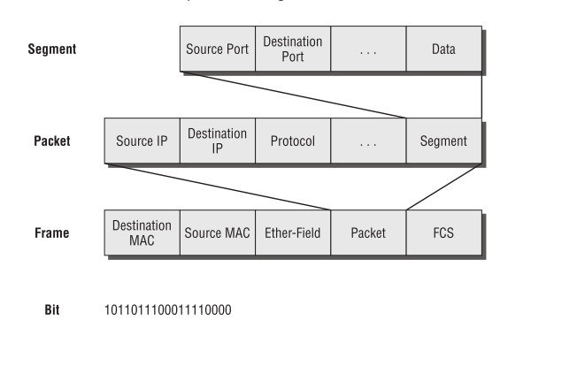
Segmentation, Packeting or Fragmentation and Framing
……

Slide 17

OSI Model Analogy
Application Layer - Source Host
After riding your new bicycle a few times in Dhaka, you decide that you want to give it to a friend who lives in Chittagong.
Notes:
“Providing service to the user” Here, Service = Bicycle User= Friend.

Slide 18

OSI Model Analogy
Presentation Layer - Source Host
Make sure you have the proper directions to disassemble and reassemble the bicycle.
Notes:
“translation, compression, and encryption” ; Here Disassemble & reassemble means that.

Slide 19

OSI Model Analogy
Session Layer - Source Host
Call your friend and make sure you have his correct address.
Notes:
“Making Communication”

Slide 20

OSI Model Analogy
Transport Layer - Source Host
Disassemble the bicycle and put different pieces in different boxes. The boxes are labeled
“1 of 3”, “2 of 3”, and “3 of 3”.
Notes:
“Segmentation & Reassemble”

Slide 21

OSI Model Analogy
Network Layer - Source Host
Put your friend's complete mailing address (and yours) on each box. Since the packages are too big for your mailbox you determine that you need to go to the post office.
Notes:
“responsible for the delivery of individual packets from the source host to the destination host”

Slide 22

OSI Model Analogy
Data Link Layer – Source Host
Dhaka post office takes possession of the boxes.
Notes:
“The data link layer is responsible for moving frames from one hop (node) to the next”

Slide 23

OSI Model Analogy
Physical Layer – Source & Destination
The boxes are flown from Dhaka to Chittagong.
Notes:
“The physical layer is responsible for movements of individual bits from one hop (node) to the next”

Slide 24
OSI Model Analogy
Data Link Layer - Destination
Chittagong post office receives your boxes.

Slide 25
OSI Model Analogy
Network Layer - Destination
Upon examining the destination address, Chittagong post office determines that your boxes should be delivered to your written home address.

Slide 26

OSI Model Analogy
Transport Layer - Destination
Your friend calls you and tells you he got all 3 boxes and he is having another friend named BOB who helps for reassemble the bicycle.

Slide 27

OSI Model Analogy
Session Layer - Destination
Your friend hangs up because he is done talking to you.

Slide 28

OSI Model Analogy
Presentation Layer - Destination
BOB is finished and “presents” the bicycle to your friend. Another way to say it is that your friend is finally getting him “present”.

Slide 29
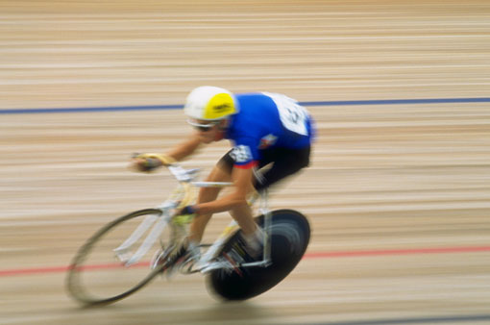
OSI Model Analogy
Application Layer - Destination
Your friend enjoys riding his new bicycle in Chittagong.

Slide 30
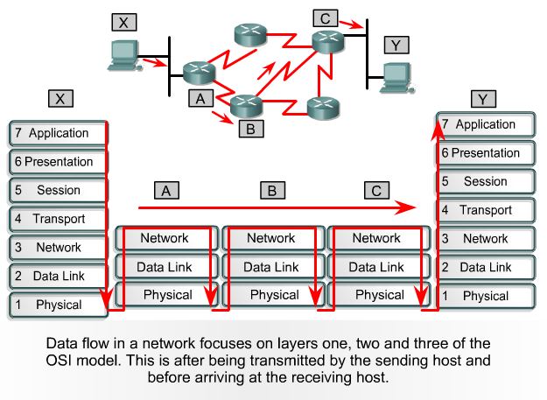
Data Flow Through a Network

Slide 31
Thank You

